Slide 1
CareerSource Florida Overview
Dehryl McCall
Director, Business and Workforce Development
December 1, 2015

Slide 2
Florida’s Economic Development Structure
Governor
CareerSource Florida
Department of Economic Opportunity
Enterprise Florida

Slide 3
Who We Are & What We Do
CareerSource Florida is the business-led policy and investment board for workforce development
We design and invest in strategies to address critical statewide workforce needs
We oversee a statewide network of career development professionals who work directly with Florida employers to help them find, develop and keep talented employees

Slide 4
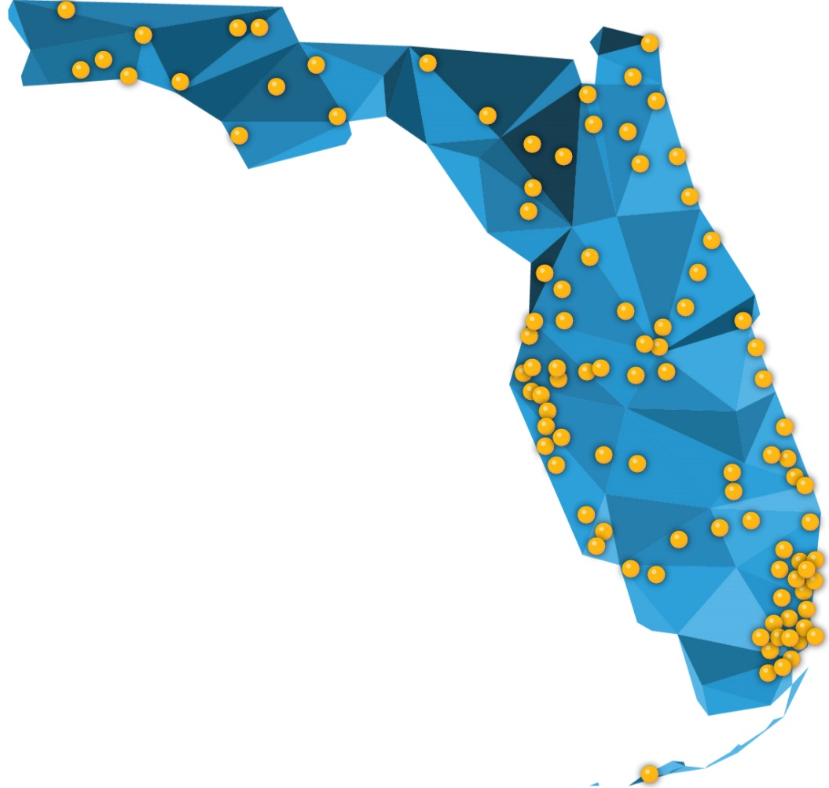
CareerSource Florida Network
24 Local Workforce Development Boards
100+ Career Centers
CareerSource Escarosa | Escambia, Santa Rosa
CareerSource Okaloosa Walton | Okaloosa, Walton
CareerSource Chipola | Calhoun, Holmes, Jackson, Liberty, Washington
CareerSource Gulf Coast | Bay, Gulf, Franklin
CareerSource Capital Region | Gadsden, Leon, Wakulla
CareerSource North Florida | Hamilton, Lafayette, Madison, Suwannee, Taylor
CareerSource Florida Crown | Columbia, Dixie, Gilchrist, Union
CareerSource Northeast Florida | Baker, Clay, Duval, Nassau, Putnam, St. Johns
CareerSource North Central Florida | Alachua, Bradford
CareerSource Citrus Levy Marion | Citrus, Levy, Marion
CareerSource Flagler Volusia | Flagler, Volusia
CareerSource Central Florida | Orange, Osceola, Seminole, Lake, Sumter
CareerSource Brevard | Brevard
CareerSource Pinellas | Pinellas
CareerSource Tampa Bay | Hillsborough
CareerSource Pasco Hernando | Pasco, Hernando
CareerSource Polk | Polk
CareerSource Suncoast | Manatee, Sarasota
CareerSource Heartland | DeSoto, Hardee, Highlands, Okeechobee
CareerSource Research Coast | Indian River, Martin, St. Lucie
CareerSource Palm Beach County | Palm Beach
CareerSource Broward | Broward
CareerSource South Florida | Miami-Dade, Monroe
CareerSource Southwest Florida | Charlotte, Collier, Glades, Hendry, Lee

Slide 5
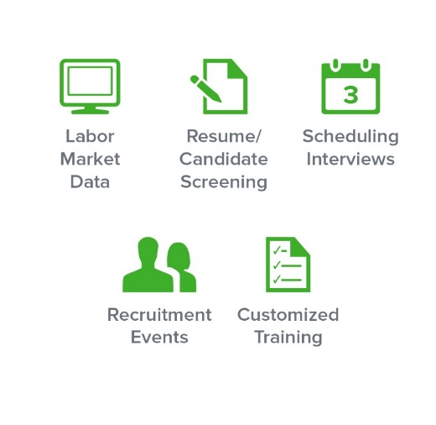
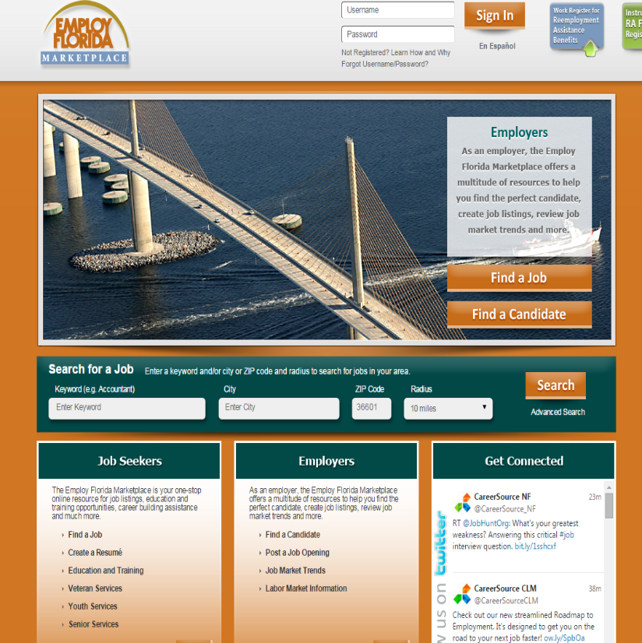
Business Services
EmployFlorida.com

Slide 6
St. Lucie County Economy
CareerSource Research Coast region (Indian River, Martin, and St. Lucie counties) has a labor force of 258,800
Major industries that gained jobs over the year: trade, transportation, and utilities (+1,400 jobs); education and health services (+1,100 jobs); leisure and hospitality (+1,000 jobs)
Annual employment growth in St. Lucie metro area: information (+7.7%); leisure and hospitality (+4.9%); education and health services (+4.7%); trade, transportation, and utilities (+3.8%)
Annual employment growth in Sebastian-Vero Beach metro area: information (+16.7%); manufacturing (+9.5%); trade, transportation, and utilities (+3.1%)

Slide 7
CareerSource Florida’s Vision for Business Engagement
Why business engagement is critical
Looking Back
Key findings / external & internal research
Actions taken
Looking Forward
Sector strategy approach
Building a skilled workforce
Opportunities

Slide 8
Business Engagement is Critical
Why?
Area Development Corporate Executive Survey 2014 – Key Location Decisions
EFI Competitiveness Study – 2012 & 2014
IEDC – 2015 Membership Survey Results & Priorities – Talent No.1 issue

Slide 9
Looking Back
Low Business Use Rate – 4.75% [DEO]
Unified Branding Business Market Research Findings
Expanding Business Engagement Research Findings

Slide 10
Actions Taken
Expanding Business Engagement
Professional Development Tool Kit
Customer Relationship Management – Salesforce.com
CareerSource Florida Network Performance Incentives

Slide 11
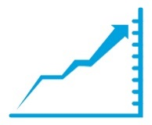
Expanding Business Engagement
July 1, 2014 – June 30, 2015
Businesses Served Statewide
Quick Response Training Grants Awarded
Open Job Positions
(June)
124,336
$11,680,980
273,134
An increase of 23,034 over last year
Projected
Trainees
7,469
Unemployment Rate (Florida)
Unemployment Rate (National)
5.5% June
5.3% June
High-Value Services Provided to Businesses
Incumbent Worker Training Grants Awarded
Job Seekers Placed with CareerSource Florida Network Assistance
236,015
$3,142,886
445,437
An increase of 58,665 over
last year
Projected
Trainees
7,148
Private-Sector Jobs Created Since Dec. 2010
896,900
Notes:
Open Job Positions – Conference Board’s - Help Wanted Online; Private Sector Jobs - EOG’s release from 7/17/15; June’s Unemployment #’s available 7/17/15.

Slide 12
Expanding Business Engagement
July 1, 2015 – October 31, 2015
Businesses Served Statewide
FloridaFlex Training Grants Awarded
Open Job Positions
(October)
36,799
$9,455,624
280,258
Projected
Trainees
5482
Unemployment Rate (Florida)
Unemployment Rate (National)
5.1% October
5.0% October
High-Value Services Provided to Businesses
Incumbent Worker Training Grants Awarded
Job Seekers Placed with CareerSource Florida Network Assistance
63,476
$606,965
150,035
Projected
Trainees
1207
Private-Sector Jobs Created Since Dec. 2010
978,800
Notes:
Open Job Positions – Conference Board’s - Help Wanted Online data available 10/4; Private Sector Jobs - EOG’s website 11/20/15; October’s Preliminary State Unemployment Rate 11/20/15.

Slide 13
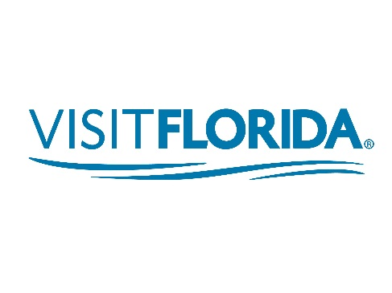
Economic Development
Supporting Florida’s Target Industries Through Customized Training
Our Partners

Slide 14
FloridaFlex
Formerly known as Quick Response Training
Nationally recognized program awarding $12 million in grants annually
Supports high wage, high growth industries including manufacturing, finance & insurance, professional services, wholesale trade, transportation & warehousing, and information technology
Flexible, business-driven grants cover training expenses after jobs have been created and training has occurred

Slide 15
Incumbent Worker Training
Federally funded training grant program for existing businesses (at least one full-time employee)
Customer-driven program; businesses may use public, private or in-house training providers
Small business-focused: priority funding given to businesses in qualified target industries with 25 or fewer employees

Slide 16
Incumbent Worker Training
Flexible to meet businesses’ needs
Business selects training provider
Business can have up to 12 months to train
Approved training costs reimbursed directly to business
Business contracts with CareerSource Florida

Slide 17
Looking Forward
Sector Strategies
Collecting business intelligence
Proactively developing solutions that meet the needs of multiple companies
State level: supportive policies & investments to support local sector partnerships
Local level: multiple partner engagement / employer-driven / focus on workforce needs in regional labor market / talent pipeline
Building a Skilled Workforce
Opportunities

Slide 18
Sector Strategies
Healthcare
Florida Healthcare Workforce Leadership Council
Advanced Manufacturing
Florida Advanced Manufacturing Workforce Leadership Council

Slide 19
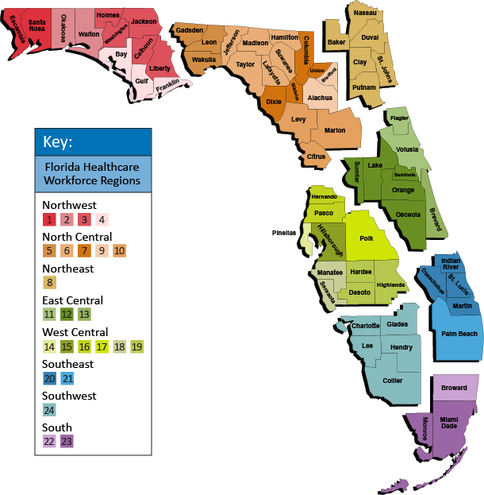
Florida Workforce Healthcare Regions

Slide 20
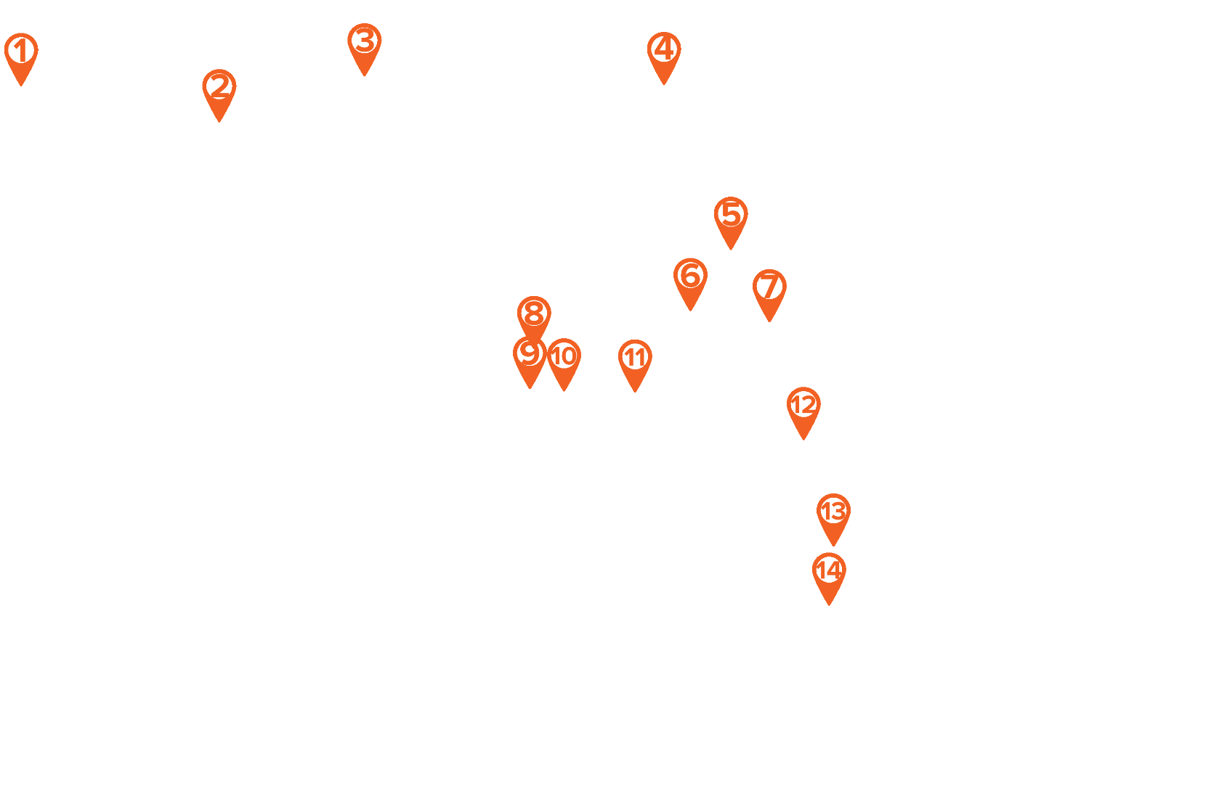
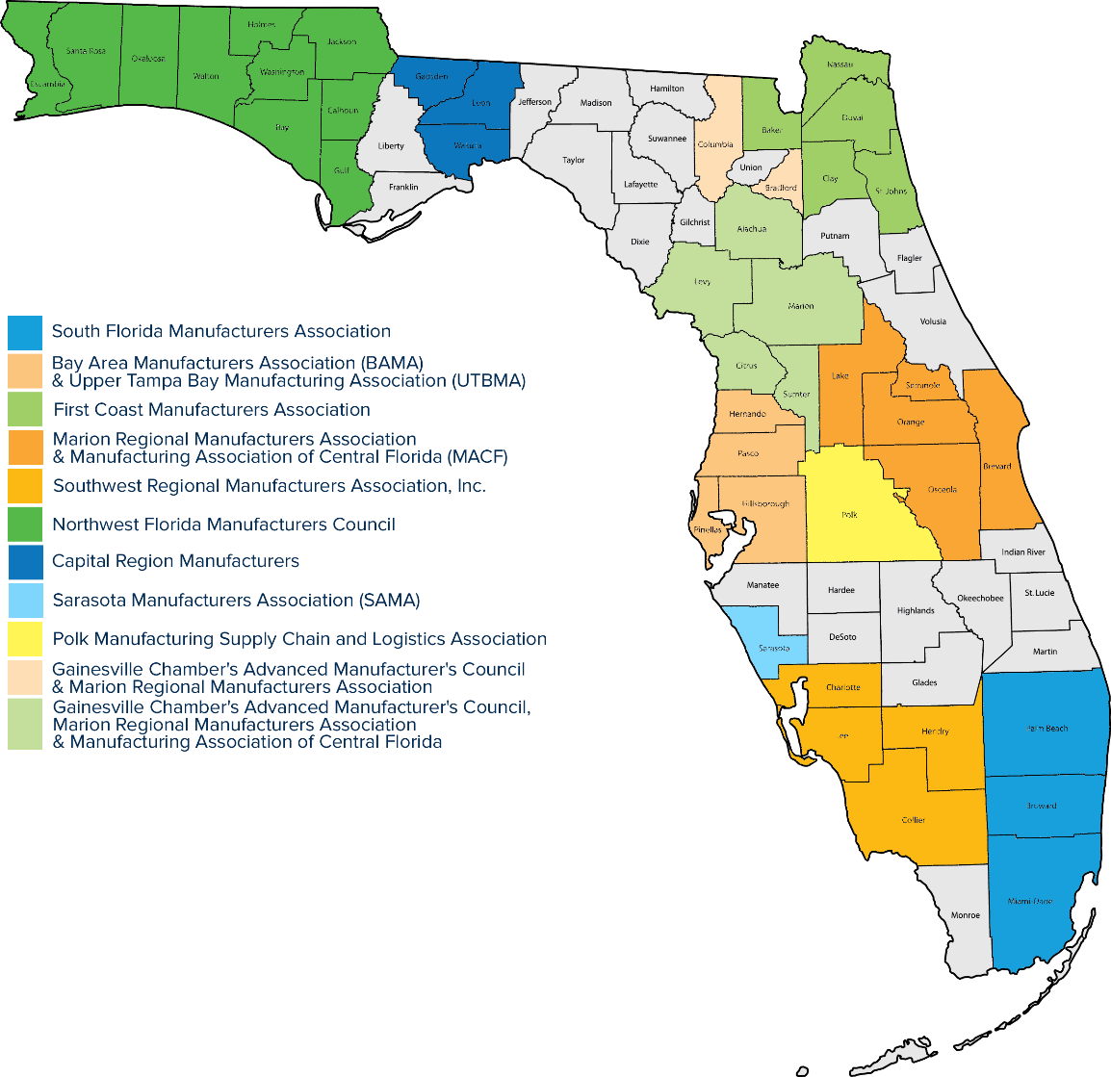
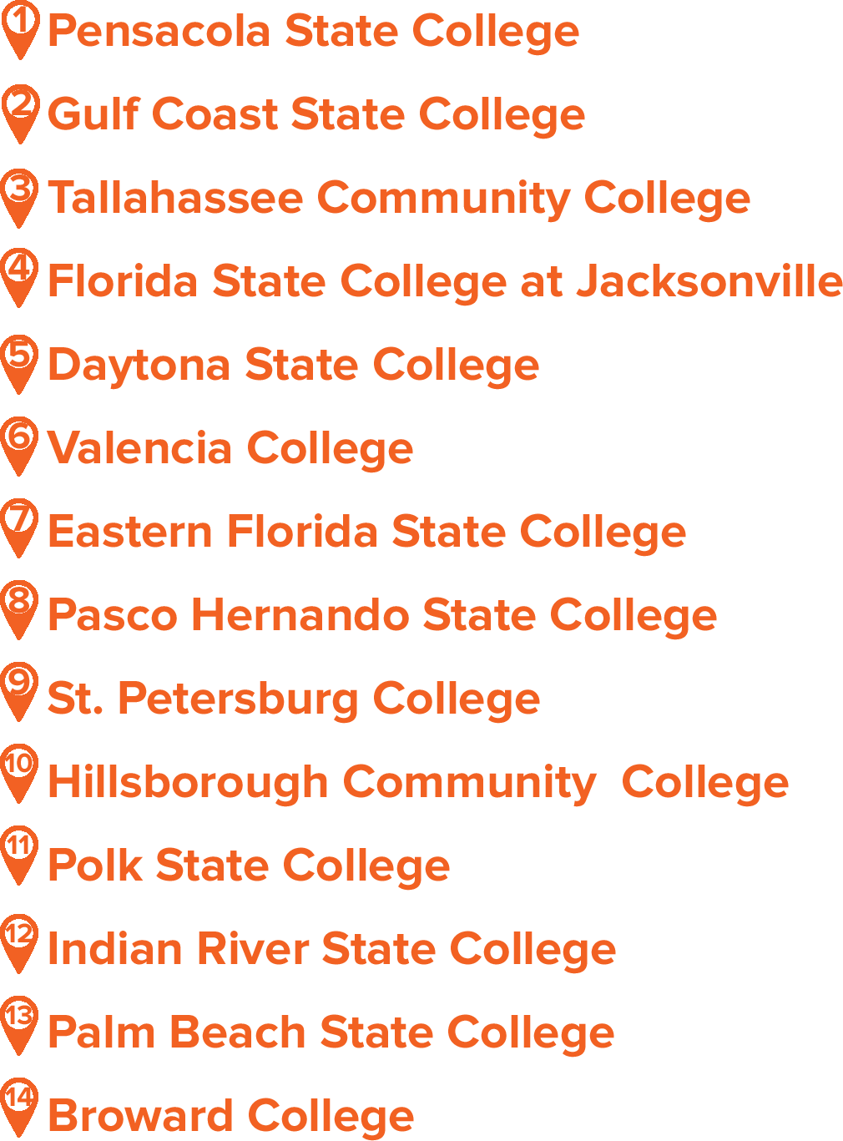
Regional Manufacturing Associations & TRADE Colleges

Slide 21
Treasure Coast Manufacturing Job Fair

Slide 22
How do we work with educators to build a skilled workforce?
Sector Strategies
Career and Professional Education Act (CAPE)

Slide 23
CAPE Academy Enrollment & Certifications Earned
*Source: Florida Department of Education Unduplicated count of high school students enrolled in at least one CAPE academy based on final Survey 5 data reported as of 2-28-14 (Source: EIAS) **Preliminary data as of December 2014

Slide 24
Registered High School Career and Professional Academies
Source: Florida Department of Education

Slide 25
Alignment with Target & Infrastructure Industries
Notes:
$25 for each student taught by a teacher who provided instruction in a course that led to the attainment of an industry certification on the 2014-15 Industry Certification Funding List with a weight of 0.1.
$50 for each student taught by a teacher who provided instruction in a course that led to the attainment of an industry certification on the 2014-15 Industry Certification Funding List with a weight of 0.2, 0.3, 0.5, or 1.0.

Slide 26
Cross-regional Work

Slide 27
CareerSource Florida Network
Business Services

Slide 28
Questions?
Dehryl McCall
850-921-1124
dmccall@careersourceflorida.com

