Slide 1
SLPS – Committed To Quality,
Innovation, And Progress
Superintendent E. Wayne Gent

Slide 2
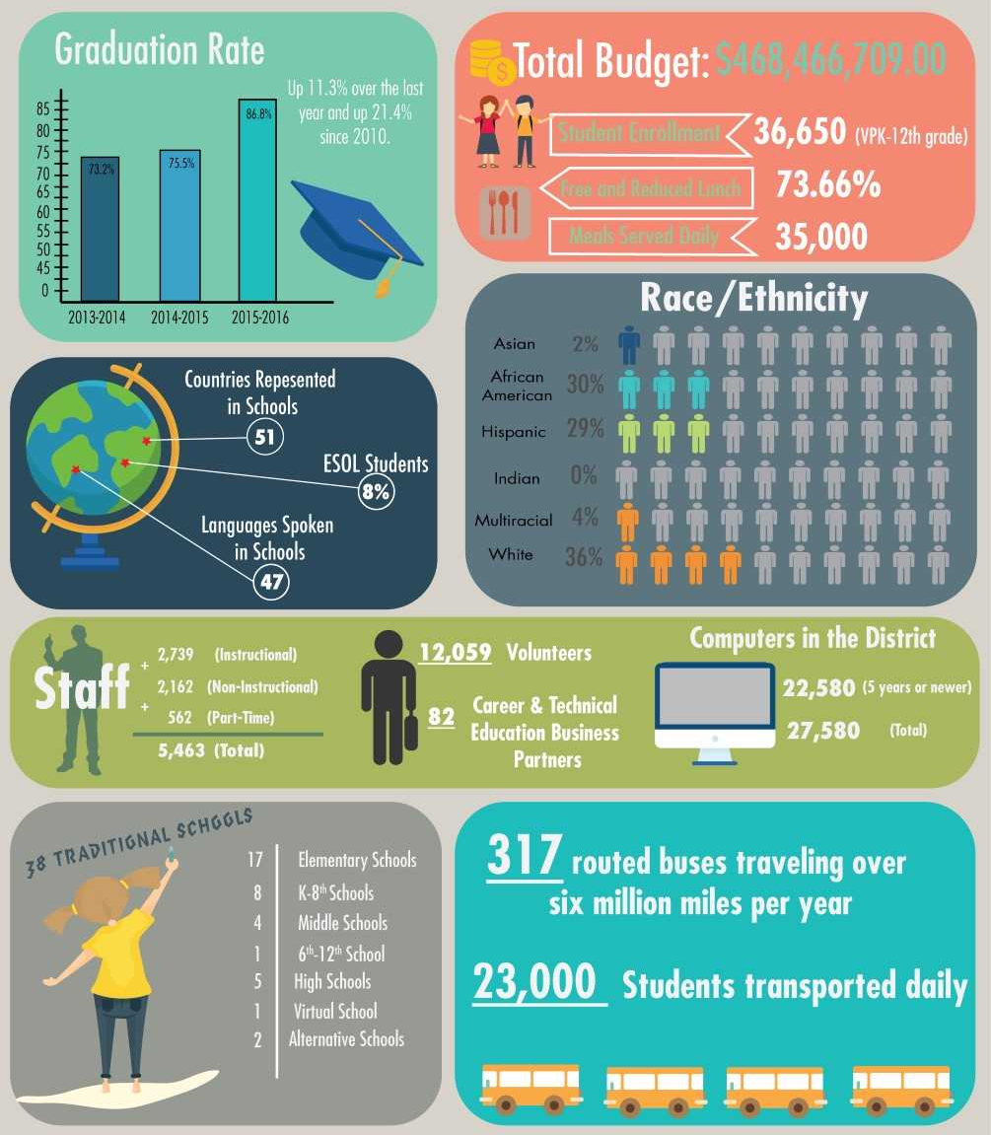
508,796,370

Slide 3
B-Rated School District
No Failing Schools
2nd Highest Ranking District On the Treasure Coast
Soared To 13th From 45th In State Graduation Ranking
6th Highest District Improvement Ranking in Florida
Grew To 626 Points From 573 Points (+53)
Improved In 10 Of 11 School Grade Components

Slide 4
District Grades Model
A Maximum Of 11 Components
English/ Language Arts | Math (Grades 3-8 FSA and EOCs) | Science (5th/8th Science + Biology) | Social Studies (Civics and US History EOC) | MS Acceleration (Alg, Geo and IC) | Graduation Rate | Acceleration Success
Achievement 50 (+3) | Achievement 54 (+8) | Achievement 53 (+1) | Achievement 67 (+4) | Achievement 67 (+9) | Overall, 4-year Graduation Rate 87 (+12) | Percent of students eligible to earn college credit through AP, IB, AICE, Dual Enrollment or earning an Industry Certification 50 (-4)
Learning Gains 54 (+3) | Learning Gains 54 (+8) | 626 (+53) 57% B
Learning Gains of the Low 25% 46 (+3) | Learning Gains of the Low 25% 45 (+6)
1100 pts
2017

Slide 5
State School Grade Points Improvement Rankings
District | District Improvement Ranking | Points Improved | District Enrollment
Suwanee | 1 | +67 | 6,056
Collier | 2 | +56 | 46,407
Jackson | 3 | +55 | 6,738
Wakulla | 4 | +55 | 5,178
Madison | 5 | +54 | 2,759
St. Lucie | 6 | +53 | 40,417
Bay | 7 | +50 | 28,027

Slide 6
Treasure Coast Points Comparisons and District Grades
District | Overall Points 15-16 | Overall Points 16-17 | Points Improved | District Grades
Martin | 659 | 690 | +31 | A
St. Lucie | 573 | 626 | +53 | B
Indian River | 606 | 623 | +17 | B
Okeechobee | 549 | 562 | +23 | C

Slide 7
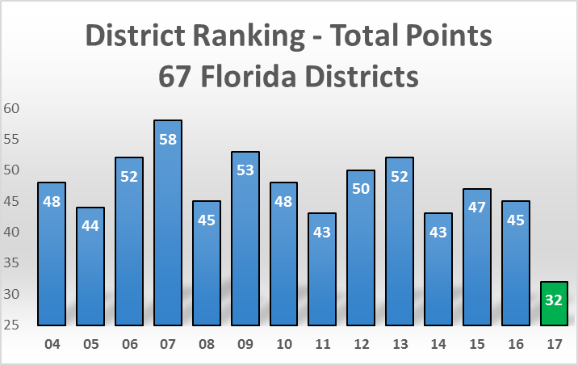
District Grades Context Ranking of District 2004-2017
Record
Results
For
SLPS

Slide 8
District Grades Context
Ranking Improved to 32nd from 45th out of 67 School Districts
Record
Results
For
SLPS
SLPS
Top 1/2

Slide 9
District-wide Results Outstanding!
Schools | Improved Grade | Declined Grade | Remained “A” | Same
Elementary | 11 | 1 |  | 5
K-8 | 3 | 1 | 2 | 3
Middle | 1 |  |  | 3
High | 4 |  | 1 | 1
Virtual | 2
Total | 21 | 2 | 3 | 12

Slide 10
St. Lucie Public Schools Grades Remarkable Improvements 15-16 to 16-17
Lincoln Park 6-12 A to A
Palm Pointe K8 A to A
West Gate K8 A to A
Fairlawn Elementary B to A
MOSAIC UPPER B to A

Slide 11
St. Lucie Public Schools Grades Remarkable Improvements 15-16 to 16-17
21/38
Fairlawn Elementary B to A
MOSAIC Upper B to A
Bayshore Elementary C to B
Floresta Elementary C to B
Frances K. Sweet Elementary C to B
Manatee K8 C to B
MOSAIC Lower C to B
Northport K-8 C to B
Oak Hammock K8 C to B
Rivers Edge Elementary C to B
Port St. Lucie High C to B
St. Lucie West Centennial C to B
Treasure Coast High C to B
Mariposa Elementary D to B
C. A. Moore Elementary F to C
Dan McCarty Middle D to C
Ft. Pierce Westwood High D to C
Lakewood Park Elementary D to C
Lawnwood Elementary D to C
Parkway Elementary D to C
St. Lucie Elementary F to D

Slide 12
St. Lucie Public Schools Grades
Southern Oaks Middle B to B
Southport Middle B to B
St. Lucie West K8 B to B
Village Green Elementary B to B
Windmill Point B to B
Allapattah Flats K8 C to C
Forest Grove Middle C to C
Ft. Pierce Central High C to C
Ft. Pierce Magnet SOA C to C
Savanna Ridge Elementary C to C
White City Elementary C to C
Morningside Elementary B to C
Weatherbee Elementary D to D
Samuel S. Gaines K8 C to D

Slide 13
School Grades
State Comparisons 2015-2016
St. Lucie Public Schools Changes | Statewide District Changes
15% Improved | 14% Improved
59% Stayed The Same | 54% Stayed The Same
26% Declined | 31% Declined
Notes:
School grades will only be based on proficiency.

Slide 14
School Grades
State Comparisons 2016-2017
St. Lucie Public Schools Changes | Statewide District Changes
51% Improved (21) | 28% Improved
41% Stayed The Same (15) | 59% Stayed The Same
5% Declined (2) | 14% Declined
Notes:
School grades will only be based on proficiency.

Slide 15
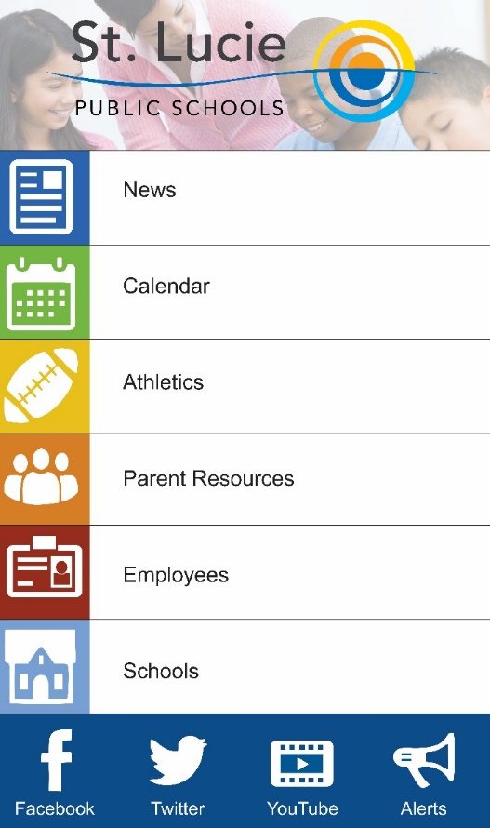
Download
Our App For Easy Access
To District News And
Resources
Search For
St. Lucie Public Schools
In Your Favorite App Store Today.

