Slide 1
Update on Kings Highway Corridor
Realtor/Landowner Roundtable & Luncheon
July 27, 2017
Transportation Planning for Fort Pierce, Port St. Lucie, St. Lucie Village and St. Lucie County

Slide 2
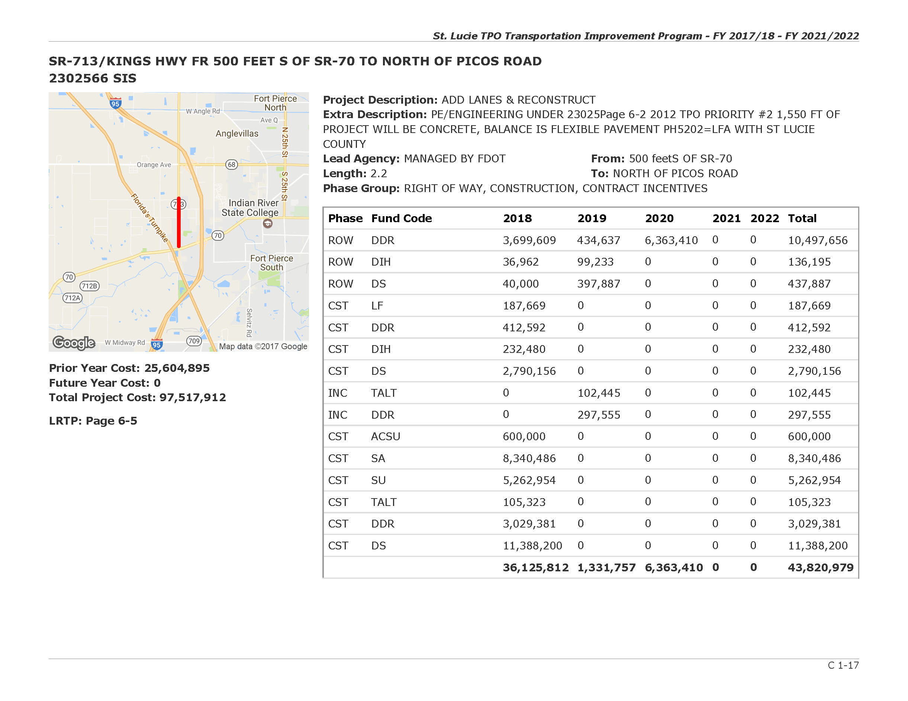

Slide 3
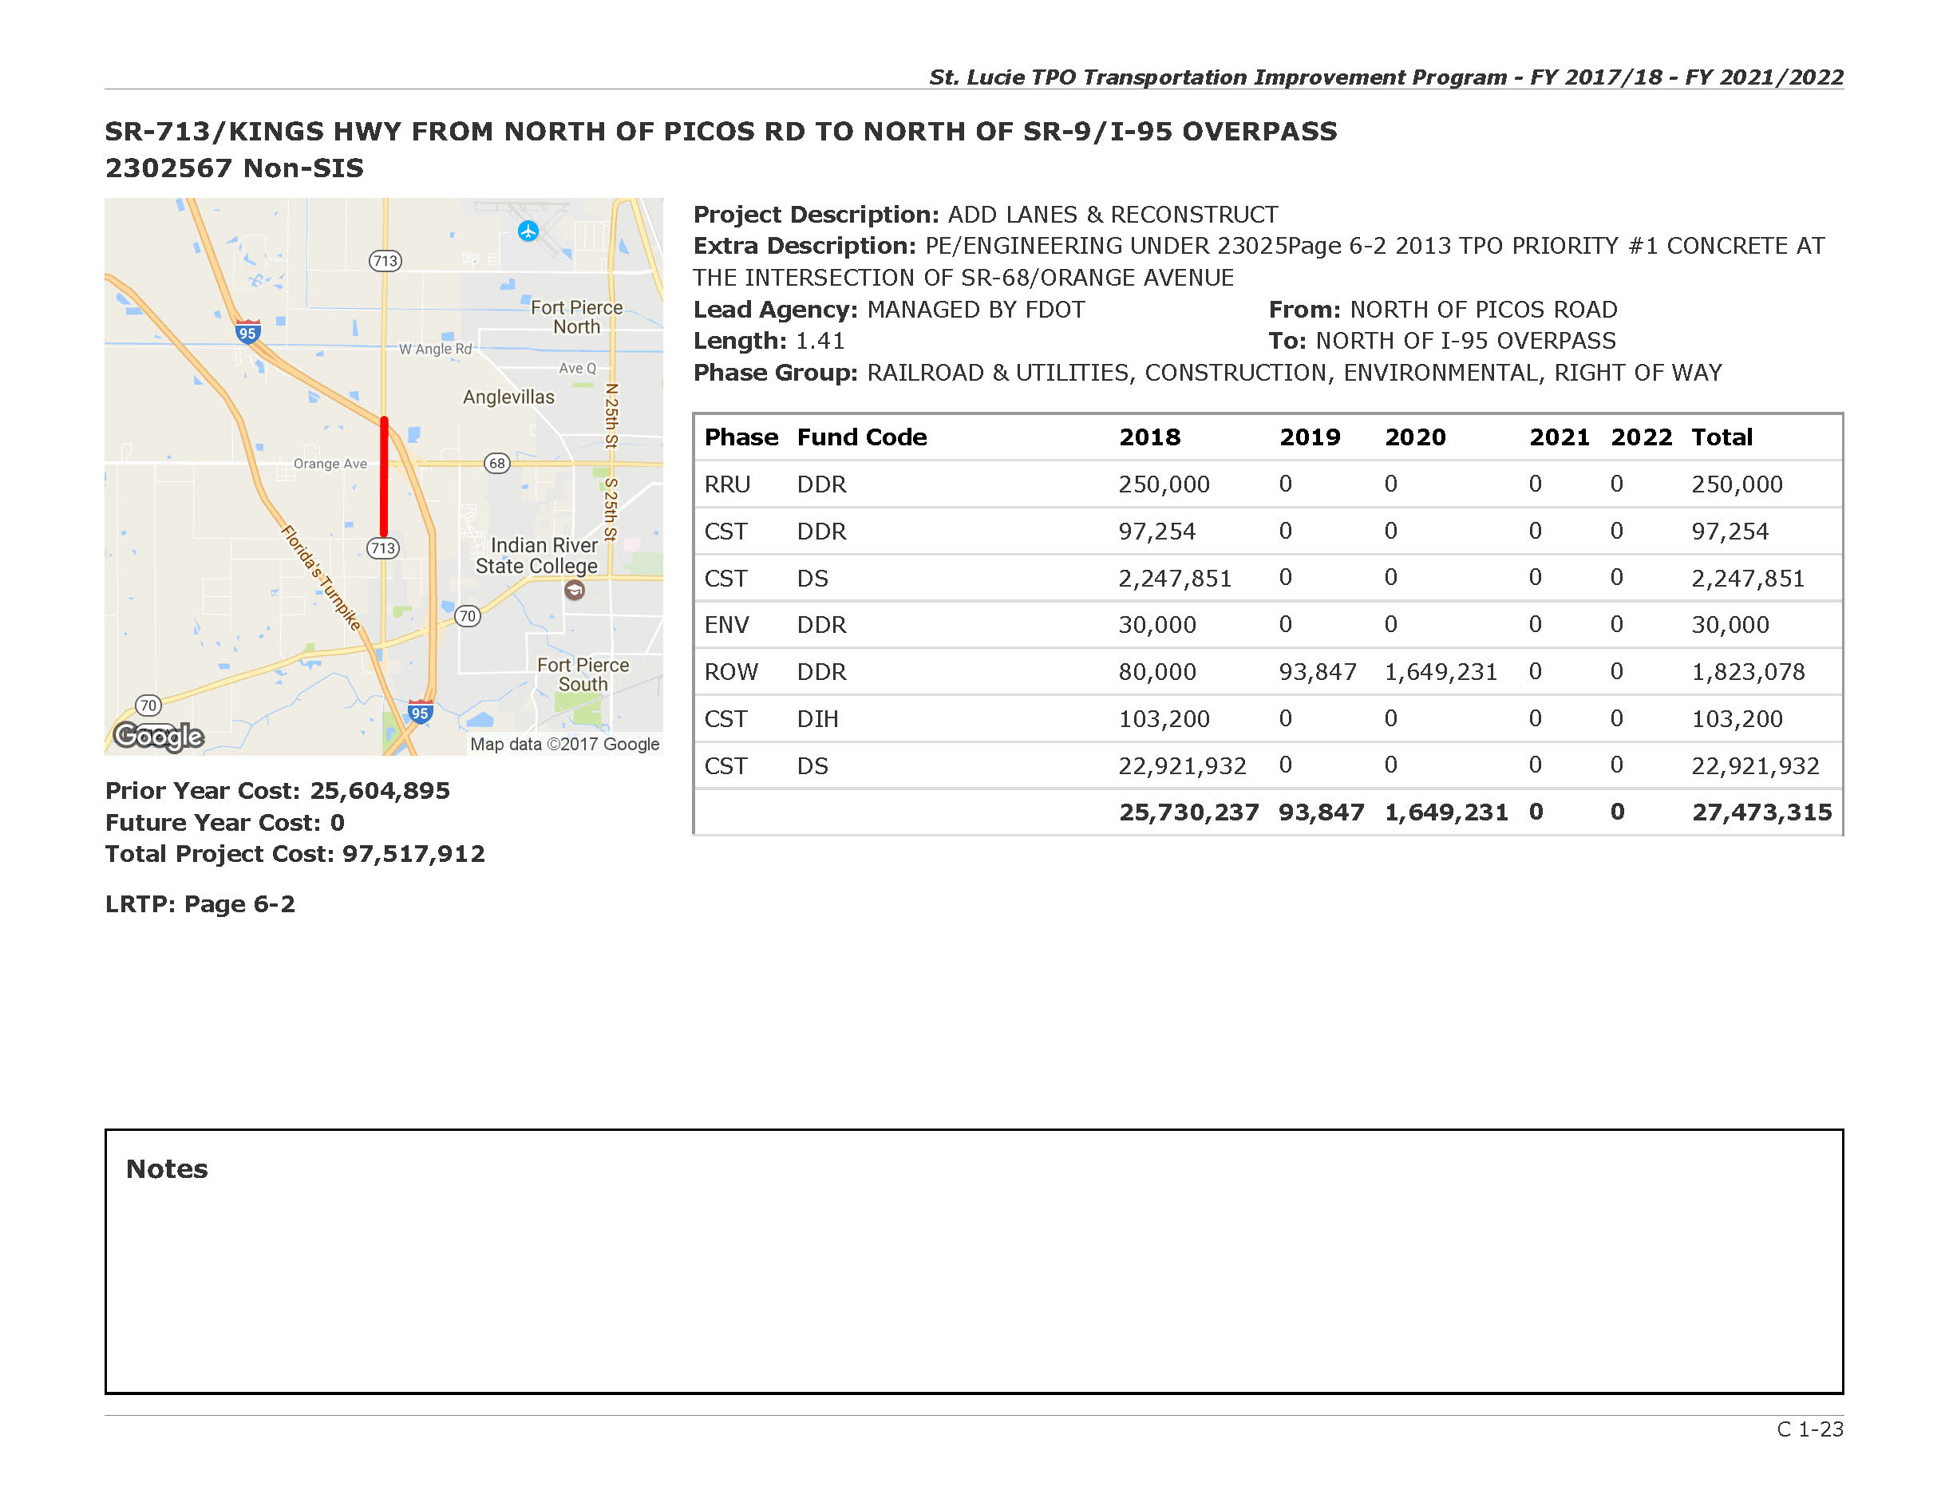

Slide 7
2017/18 List of Priority Projects Adopted June 7, 2017
Master List
2017/18 Priority Ranking | Facility | Project Limits |  | Project Description | Project Status/Notes | In LRTP Cost Feasible Plan? | Estimated Cost | 2016/17 Priority Ranking
 |  | From | To
1 | Port St. Lucie Boulevard | Paar Drive | Darwin Boulevard | Add 2 lanes, sidewalks, bicycle lanes | PE and ROW in process | Yes | $28,995,975 | 1
2 | Midway Road | Glades Cut Off Road | Selvitz Road | Add 2 lanes, sidewalks, bicycle lanes | PE in process, ROW to start in FY 2018/19 | Yes | $43,792,757 | 2
3 | Port St. Lucie Boulevard | Becker Road | Paar Drive | Add 2 lanes, sidewalks, bicycle lanes | PE to start in FY 2020/21 | Yes | $15,541,965 | 3
4 | Kings Highway | I-95 Overpass | Commercial Circle | Add 2 lanes, sidewalks, bicycle lanes | PE to start in FY 2017/18, ROW to start in FY 2019/20 | Yes | $44,764,467 | 4
 |  | Commercial Circle | St. Lucie Boulevard | Add 2 lanes, sidewalks, bicycle lanes | PE to start in FY 2018/19, ROW to start in FY 2021/22
5 | I-95 Interchange | At St. Lucie West Boulevard |  | Ramp and approach improvements for new 3-lane bridge to complete interchange with sidewalks and bicycle lanes | PE for interchange in process, Construction of bridge to start in FY 2018/19 | Yes | $5,000,000 | NR
6 | Kings Highway | St. Lucie Boulevard | Indrio Road | Add 2 lanes, sidewalks, bicycle lanes |  | Yes | $40,000,000 | NR

Slide 8
Next TPO Board Meeting
Wednesday, August 2, 2017
2:00 pm

